Slide 1
Loop Construct in Python
Session 3

Slide 2
Objectives
Introduction to Loops
  while
  for
  nested loop
Jump Statements
  break
  continue
  pass

Slide 3
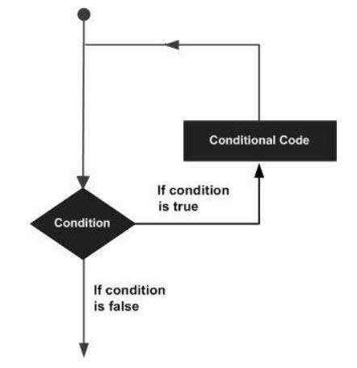
Python - Loops
In general, statements are executed sequentially: The first statement in a function is executed first, followed by the second, and so on. There may be a situation when you need to execute a block of code several number of times.
Programming languages provide various control structures that allow for more complicated execution paths.
A loop statement allows us to execute a statement or group of statements multiple times.
The following diagram illustrates a loop statement −

Slide 4
Advantages of loops
There are the following advantages of loops in Python.
  It provides code re-usability.
  Using loops, we do not need to write the same code again and again.
  Using loops, we can traverse over the elements of data structures (array or linked lists).

Slide 5
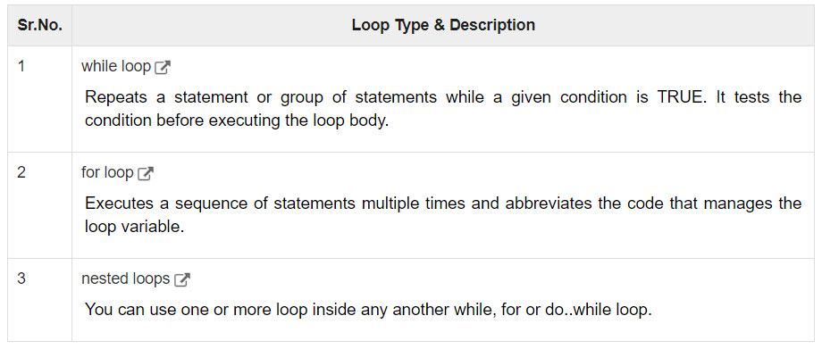
Python - Loops
Python programming language provides following types of loops to handle looping requirements.

Slide 6

while Loop Statements
A while loop statement in Python programming language repeatedly executes a target statement as long as a given condition is true.
Syntax
Here, statement(s) may be a single statement or a block of statements. The condition may be any expression, and true is any non-zero value. The loop iterates while the condition is true.
When the condition becomes false, program control passes to the line immediately following the loop.
In Python, all the statements indented by the same number of character spaces after a programming construct are considered to be part of a single block of code. Python uses indentation as its method of grouping statements.

Slide 7
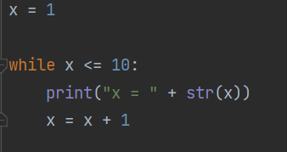
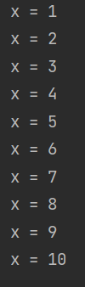
while Loop Statements
Example:
Output:

Slide 8
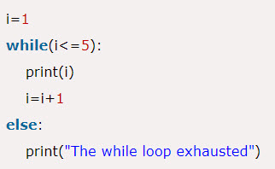
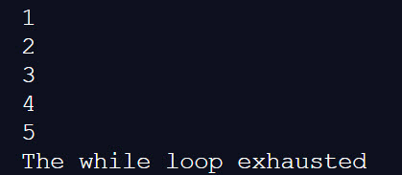
Using else with while loop
Python allows us to use the else statement with the while loop also. The else block is executed when the condition given in the while statement becomes false. Like for loop, if the while loop is broken using break statement, then the else block will not be executed, and the statement present after else block will be executed. The else statement is optional to use with the while loop.
Example:
Output:

Slide 9

for Loop Statements
It has the ability to iterate over the items of any sequence, such as a list or a string.
Syntax
If a sequence contains an expression list, it is evaluated first. Then, the first item in the sequence is assigned to the iterating variable iterating_var.
Next, the statements block is executed. Each item in the list is assigned to iterating_var, and the statement(s) block is executed until the entire sequence is exhausted.

Slide 10
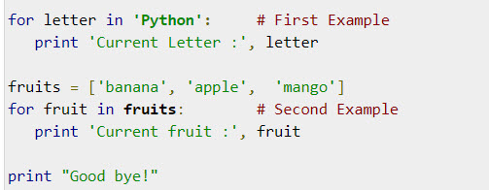
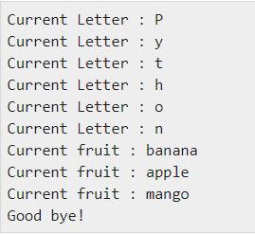
for Loop Statements
Example
Output

Slide 11

for loop Using range() function
The range() function
  The range() function is used to generate the sequence of the numbers. If we pass the range(10), it will generate the numbers from 0 to 9.
  The syntax of the range() function is given below:
  The start represents the beginning of the iteration.
  The stop represents that the loop will iterate till stop-1. The range(1,5) will generate numbers 1 to 4 iterations. It is optional.
  The step size is used to skip the specific numbers from the iteration. It is optional to use. By default, the step size is 1. It is optional.

Slide 12
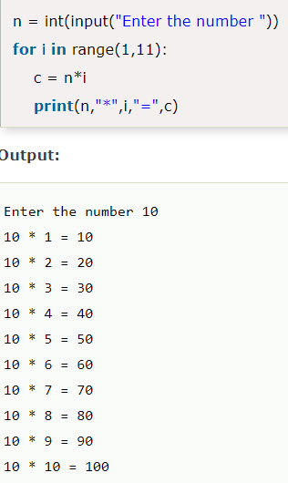
for loop Using range() function
Example: Program to print table of given number.

Slide 13
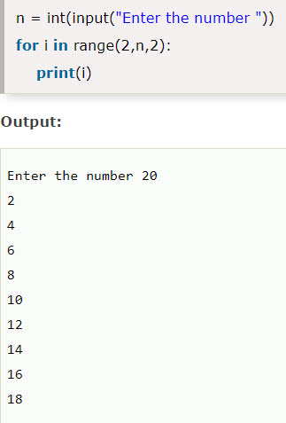
for loop Using range() function
Example: Program to print even number using step size in range().

Slide 14
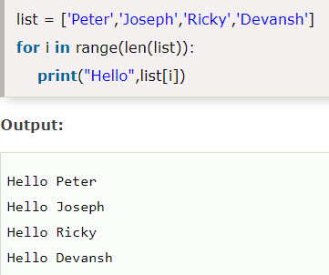
for loop Using range() function
We can also use the range() function with sequence of numbers. The len() function is combined with range() function which iterate through a sequence using indexing.

Slide 15
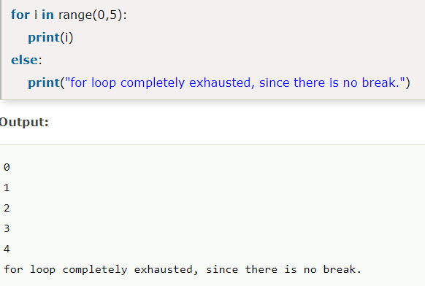
Using else statement with for loop
Unlike other languages like C, C++, or Java, Python allows us to use the else statement with the for loop which can be executed only when all the iterations are exhausted. Here, we must notice that if the loop contains any of the break statement then the else statement will not be executed.
Example:

Slide 16
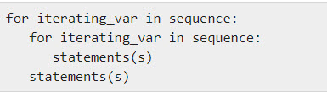
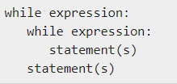
Python nested loops
Python programming language allows to use one loop inside another loop. Following section shows few examples to illustrate the concept.
Syntax
The syntax for a nested while loop statement in Python programming language is as follows −
A final note on loop nesting is that you can put any type of loop inside of any other type of loop. For example a for loop can be inside a while loop or vice versa.

Slide 17
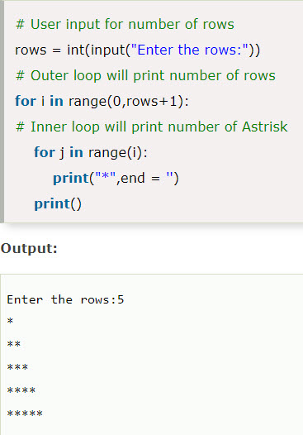
Python nested loops
Example 1:

Slide 18
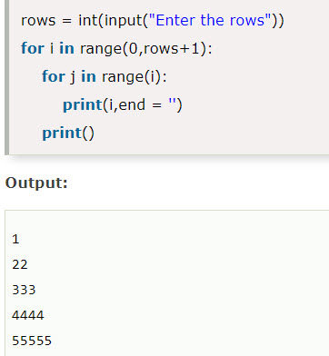
Python nested loops
Example-2: Program to number pyramid.

Slide 19
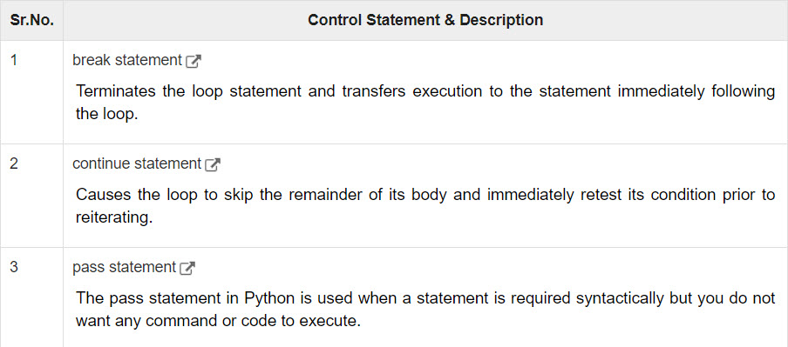
Loop Control Statements
Loop control statements change execution from its normal sequence. When execution leaves a scope, all automatic objects that were created in that scope are destroyed.

Slide 20
Python break statement
It terminates the current loop and resumes execution at the next statement, just like the traditional break statement in C.
The most common use for break is when some external condition is triggered requiring a hasty exit from a loop. The break statement can be used in both while and for loops.
If you are using nested loops, the break statement stops the execution of the innermost loop and start executing the next line of code after the block.

Slide 21
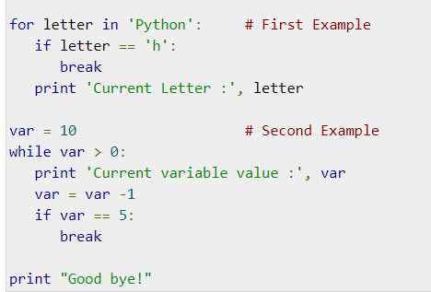
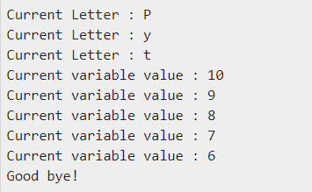
Python break statement
Example
Output

Slide 22
Python continue statement
It returns the control to the beginning of the while loop.. The continue statement rejects all the remaining statements in the current iteration of the loop and moves the control back to the top of the loop.
The continue statement can be used in both while and for loops.

Slide 23
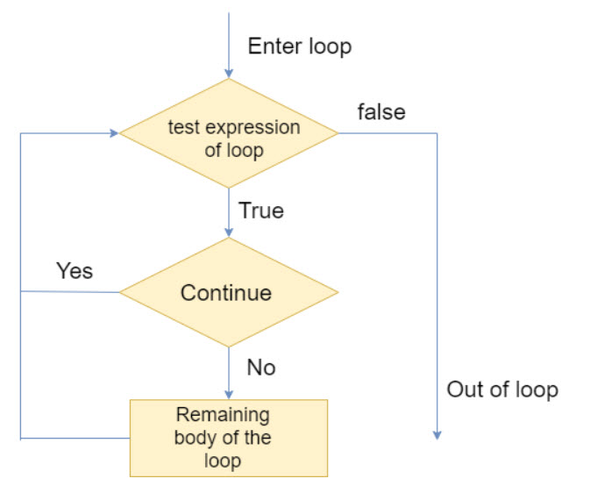
Python continue statement
Flow Diagram

Slide 24
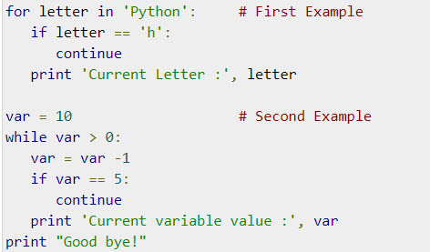
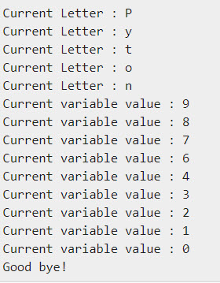
Python continue statement
Example
Output

Slide 25
Python pass statement
The pass keyword as name suggests, does nothing. It is used as a dummy place holder whenever a syntactical requirement of a certain programming element is to be fulfilled without assigning any operation.
In other words, the pass statement is simply ignored by the Python interpreter and can be seen as a null statement. It is generally used as a dummy statement in a code block, for example in the if or else block.
It is used when a statement is required syntactically but you do not want any command or code to execute.
The pass statement is a null operation; nothing happens when it executes. The pass is also useful in places where your code will eventually go, but has not been written yet (e.g., in stubs for example) −

Slide 26
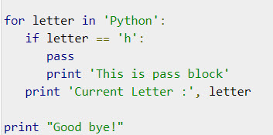
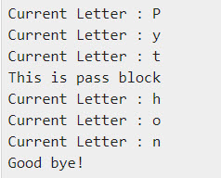
Python pass statement
Example
Output

Slide 27
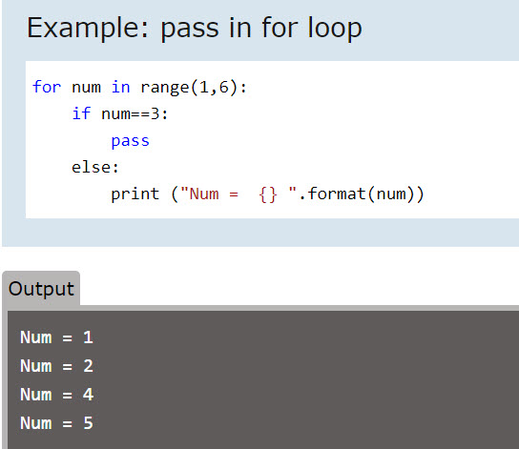
Python pass statement

Slide 28
Summary
Introduction to Loops
  while
  for
  nested loop
Jump Statements
  break
  continue
  pass

